Slide 1

Technical Debt Is Not Free

Slide 2




Slide 3

Independent. Innovative. And always open source.
dotnetfoundation.org

Slide 4


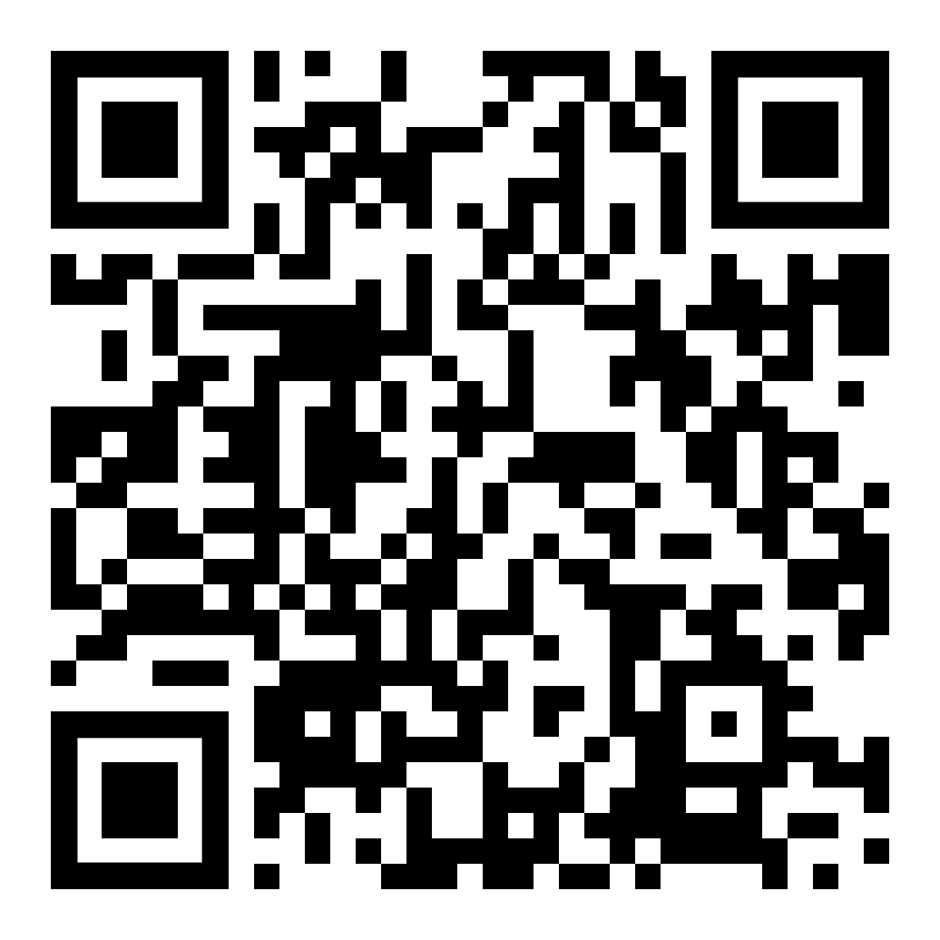
.NET Foundation Virtual User Group
Find virtual .NET events happening around the globe!
meetup.com/dotnet-virtual-user-group

Slide 5




August 17 – 19, 2022
Keynote – Christina Aldan
.NET Rocks! 20th Anniversary Party
A Toast to Women in Technology

Slide 6


Slide 7


Slide 8








Who is Chad Green
chadgreen@chadgreen.com
TaleLearnCode
ChadGreen.com
ChadGreen & TaleLearnCode
ChadwickEGreen

Slide 9
Agenda
What is Technical Debt
Pros and Cons of Technical Debt
What Causes Technical Debt
Types of Technical Debt
Technical Debt Identification
Tracking Technical Debt

Slide 10
Technical Debt Numbers
Notes:
52% of engineers believe that technical debt negatively impacts their team’s morale
60% of engineers think that tech debt causes bugs, outages, and slows down the development process
65% of engineering team members claim that most of the technical debt lives in the backend

Slide 11
What is Technical Debt
Technical Debt is not Free

Slide 12

What is Technical Debt?
First described by Ward Cunningham in 1992
The danger occurs when the debt is not repaid.
Notes:
“Shipping first-time code is like going into debt. A little debt speeds development so long as it is paid back promptly with a rewrite. Objects make the cost of this transaction tolerable.
The danger occurs when the debt is not repaid.
Every minute spent on not-quite-right code counts as interest on that debt.
Entire engineering organizations can be brought to a stand-still under the debt load of an unconsolidated implementation, object-oriented or otherwise."

Slide 13
What is Technical Debt?
First described by Ward Cunningham in 1992
Every minute spent on not-quite-right code counts as interest on that debt.
Notes:
“Shipping first-time code is like going into debt. A little debt speeds development so long as it is paid back promptly with a rewrite. Objects make the cost of this transaction tolerable.
The danger occurs when the debt is not repaid.
Every minute spent on not-quite-right code counts as interest on that debt.
Entire engineering organizations can be brought to a stand-still under the debt load of an unconsolidated implementation, object-oriented or otherwise."

Slide 14
What is Technical Debt?
First described by Ward Cunningham in 1992
…brought to a stand-still under the debt load of an unconsolidated implementation
Notes:
“Shipping first-time code is like going into debt. A little debt speeds development so long as it is paid back promptly with a rewrite. Objects make the cost of this transaction tolerable.
The danger occurs when the debt is not repaid.
Every minute spent on not-quite-right code counts as interest on that debt.
Entire engineering organizations can be brought to a stand-still under the debt load of an unconsolidated implementation, object-oriented or otherwise."

Slide 15

What is Technical Debt?
Common definition from Martin Fowler
quick and dirty way
Notes:
In this metaphor, doing things
the quick and dirty way sets us up with a technical debt, which is similar to a financial debt. Like a financial debt, the technical debt
incurs interest payments, which come in the form of the
extra effort that we have to do in future development.

Slide 16
What is Technical Debt?
Common definition from Martin Fowler
incurs interest payments
Notes:
In this metaphor, doing things
the quick and dirty way sets us up with a technical debt, which is similar to a financial debt. Like a financial debt, the technical debt
incurs interest payments, which come in the form of the
extra effort that we have to do in future development.

Slide 17
What is Technical Debt?
Common definition from Martin Fowler
extra effort that we have to do in future development
Notes:
In this metaphor, doing things
the quick and dirty way sets us up with a technical debt, which is similar to a financial debt. Like a financial debt, the technical debt
incurs interest payments, which come in the form of the
extra effort that we have to do in future development.

Slide 18

What is Technical Debt?
implied cost
Notes:
The implied cost of additional
rework caused by
choosing an easy (limited) solution now instead of using a
better approach that would take longer.

Slide 19
What is Technical Debt?
rework
Notes:
The implied cost of additional
rework caused by
choosing an easy (limited) solution now instead of using a
better approach that would take longer.

Slide 20
What is Technical Debt?
choosing easy
Notes:
The implied cost of additional
rework caused by
choosing an easy (limited) solution now instead of using a
better approach that would take longer.

Slide 21
What is Technical Debt?
better approach
Notes:
The implied cost of additional
rework caused by
choosing an easy (limited) solution now instead of using a
better approach that would take longer.

Slide 22
A more reasonable definition
A state of unnecessary complexity, duplication, subpar code, or otherwise deficient code that introduces risks in the form of time, quality, security, team morale, or other forms. Typically the results of past action or inaction.
Matt Eland
Killalldefects.com/2019/12/23/defining-technical-debt

Slide 23
Technical Debt is Bad

Slide 24
Technical Debt is Bad

Slide 25
Technical Debt can be Bad

Slide 26
Technical Debt can be Devastating

Slide 27
Technical Debt can be Useful

Slide 28
Technical Debt can be Beneficial

Slide 29
Technical Debt is not Free

Slide 30
Technical Debt Example
No User Roles
Notes:
You start writing an application. In the beginning there is no need for user roles. Everyone can do anything.

Slide 31
Technical Debt Example
No User Roles
Permission for Specific Requirement
Notes:
At some point you start having two different permissions for a specific action, like one kind of user can see a report and the others can’t. The tech team considers whether to create a full fledged permission system, using a nice set of design patterns for it. But at this point it really looks like over engineering. One method in the business logic and one in the presentation layer will do.

Slide 32
Technical Debt Example
No User Roles
Permission for Specific Requirement
Differentiation of Users
Notes:
Some time later another thing requires the differentiation of users, and then another and another. At this point the developers realize that the code is starting to get messy and the solution is refactoring it to have a decent permission system. To make this refactoring will take way more time than just adding another method, but will simplify the code and make future permissions to be added with one line of code, or even by just adding a row in the database.

Slide 33
Technical Debt Example
No User Roles
Permission for Specific Requirement
Differentiation of Users
Yet Another Permission Change
Notes:
The company has the opportunity to add five customers in a week – but really need another permission change in a couple of days
The problem is that there really is a business need to have the current permission live in one or two days, ‘cause this will make five potential customers sign a contract this week, rather than next week, or maybe never, if they dislike the fact that the company haven’t done their only request.

Slide 34
Technical Debt Example
No User Roles
Permission for Specific Requirement
Differentiation of Users
Yet Another Permission Change

Slide 35
Another Technical Debt Example
.NET 5
Current Release
.NET 6
LTS Release
Notes:
Long Term Support (LTS) _ LTS releases are supported for three years after the initial release.
Current – Current releases are supported for six months after a subsequent Current or LTS release. Release happen every 12 months, so the support period for Current is 18 months.
.NET 5 – Original Release Date – November 10, 2020
.NET 5 – End of Support – May 10, 2022
.NET 6 – Original Release Date – November 8, 2021
.NET 6 – End of Support – November 13, 2022

Slide 36
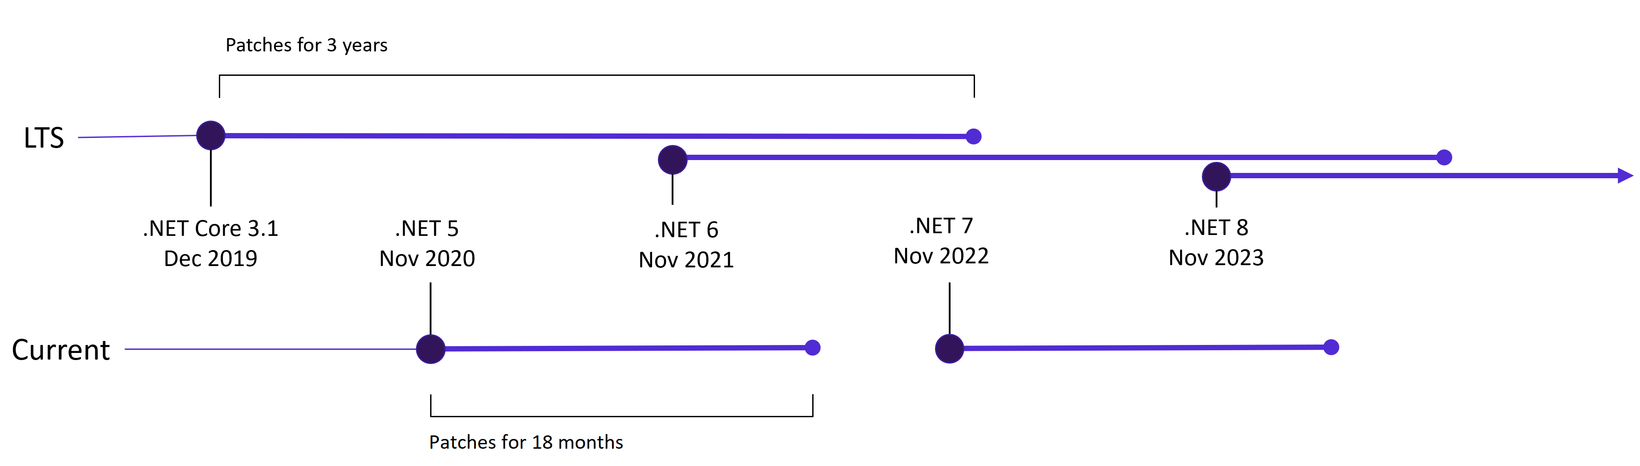
Another Technical Debt Example

Slide 37
Pros and Cons of Technical Debt
Technical Debt is not Free

Slide 38
Technical Debt Pros
Supplier
Customer
Faster time to market
Short term competitive advantage
New features faster
Short term capital preservation

Slide 39
Technical Debt Cons
Supplier
Customer
Degradation of quality
Limits ability to innovate
Longer development cycles
Less responsive to market changes
Customer churn
Developer churn
Higher upgrade costs
System compatibility issues
Poor end user experience
Less responsive to market changes
Poor IT morale

Slide 40
What Causes Technical Debt?
Technical Debt is not Free

Slide 41

Insufficient up-front definition
What causes technical debt?
Notes:
Insufficient up-front definition, where requirements are still being defined during development, development starts before any design takes place. This is done to save time but often has to be reworked later.

Slide 42

Business Pressures
What causes technical debt?
Notes:
Business pressures, where the business considers getting something released sooner before all of the necessary changes are complete, builds up technical debt comprising those uncompleted changes.

Slide 43

Lack of process or understanding
What causes technical debt?
Notes:
Lack of process or understanding, where businesses are blind to the concept of technical debt, and make decisions without considering the implications.

Slide 44

Tightly-coupled components
What causes technical debt?
Notes:
Tightly-coupled components, where functions are not modular, the software is not flexible enough to adapt to changes in business needs.

Slide 45

Lack of a test suite
What causes technical debt?
Notes:
Lack of a test suite, which encourages quick and risky band-aids to fix bugs.

Slide 46
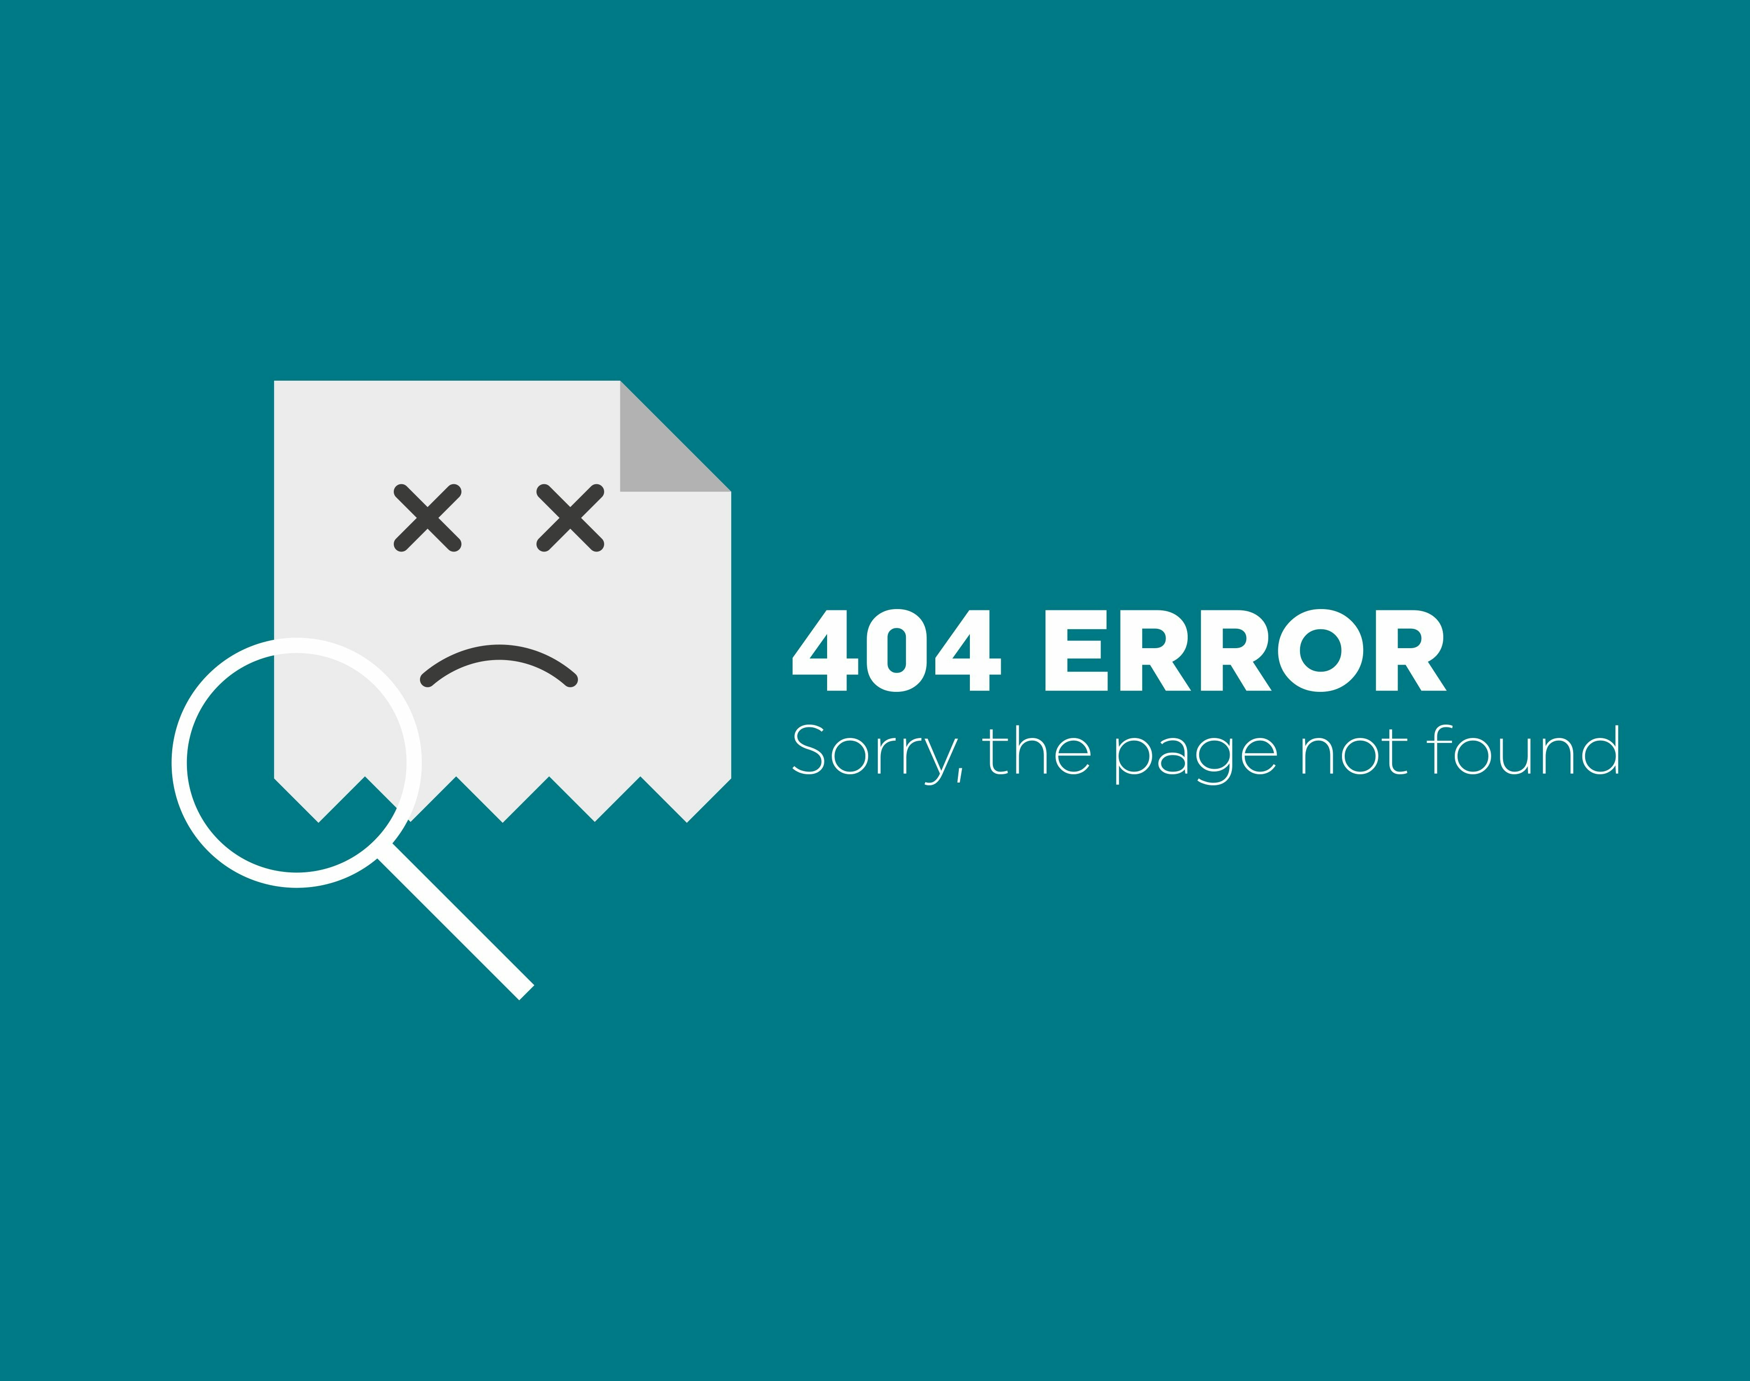
Lack of documentation
What causes technical debt?
Notes:
Lack of documentation, where code is created without necessary supporting documentation. The work to create any supporting documentation represents a debt that must be paid.

Slide 47

Lack of collaboration
What causes technical debt?
Notes:
Lack of collaboration, where knowledge isn't shared around the organization and business efficiency suffers, or junior developers are not properly mentored.

Slide 48

Parallel development
What causes technical debt?
Notes:
Parallel development on two or more branches accrues technical debt because of the work required to merge the changes into a single source base. The more changes that are done in isolation, the more debt is piled up.

Slide 49

Delayed refactoring
What causes technical debt?
Notes:
Delayed refactoring – As the requirements for a project evolve, it may become clear that parts of the code have become inefficient or difficult to edit and must be refactored in order to support future requirements. The longer that refactoring is delayed, and the more code is added, the bigger the debt.

Slide 50

Lack of alignment to standards
What causes technical debt
Notes:
Lack of alignment to standards, where industry standard features, frameworks, technologies are ignored. Eventually, integration with standards will come, doing sooner will cost less (similar to 'delayed refactoring').

Slide 51

Lack of knowledge
What causes technical debt?
Notes:
Lack of knowledge, when the developer simply doesn't know how to write elegant code.

Slide 52

Lack of ownership
What causes technical debt?
Notes:
Lack of ownership, when outsourced software efforts result in in-house engineering being required to refactor or rewrite outsourced code.

Slide 53

Poor technical leadership
What causes technical debt?
Notes:
Poor technological leadership where poorly thought out commands handed down the chain of command increases the technical debt rather than reduce it.

Slide 54

Last minute specification changes
Notes:
Last minute specification changes; these have potential to percolate throughout a project but no time or budget to see them through with documentation and checks.

Slide 55
What causes technical debt?
Insufficient up-front definition
Business pressures
Lack of process or understanding
Tightly-coupled components
Lack of a test suite
Lack of documentation
Lack of collaboration
Parallel development
Delayed refactoring
Lack of alignment to standards
Lack of knowledge
Lack of ownership
Poor technical leadership
Last minute specification changes

Slide 56
Types of Technical Debt
Technical Debt is not Free

Slide 57
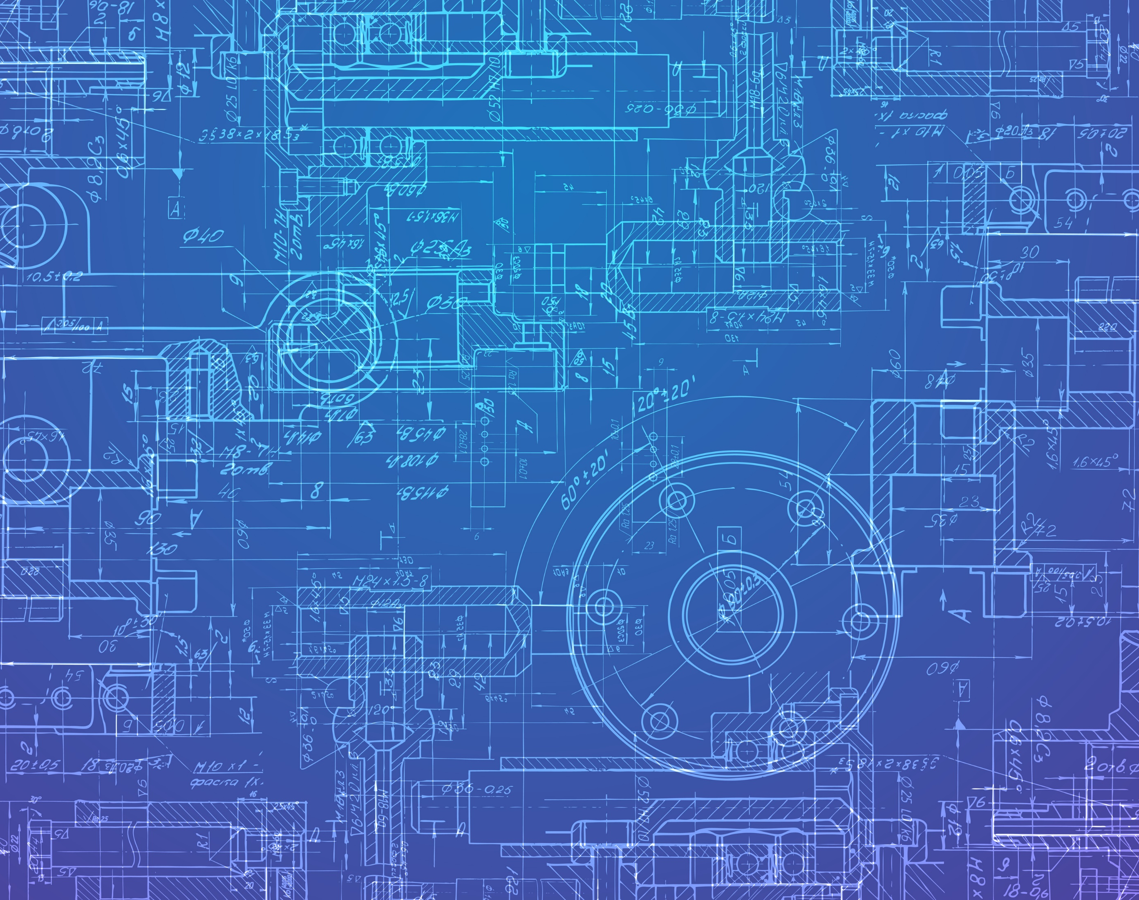
Architecture
Types of Technical Debt
Notes:
Architecture debt : Refers to problems encountered in architecture – for example, violation of modularity – that can affect architectural requirements (including performance and robustness, among others).

Slide 58

Build
Types of Technical Debt
Notes:
Build debt : Refers to issues that make builds more difficult or resource consuming than necessary.

Slide 59

Code
Types of Technical Debt
Notes:
Code debt : Refers to problems found in the source code that make it more difficult to be maintained.

Slide 60

Defect
Types of Technical Debt
Notes:
Defect debt : Refers to known defects, usually identified by testing activities or by the user, that the change control board agrees should be fixed, but have been deferred due to competing priorities and limited resources.

Slide 61

Design
Types of Technical Debt
Notes:
Design debt : Refers to debt that can be discovered by analyzing the source code and identifying the use of practices that violate the principles of good object-oriented design (for example, very large or tightly coupled classes).

Slide 62

Documentation
Types of Technical Debt
Notes:
Documentation debt : Refers to problems found in software project documentation, including missing, inadequate, or incomplete documentation of any type.

Slide 63

Infrastructure
Types of Technical Debt
Notes:
Infrastructure debt : Refers to infrastructure issues that can delay or hinder some development activities.

Slide 64

People
Types of Technical Debt
Notes:
People debt : Refers to people issues – for example, expertise concentrated in too few people as a result of delayed training – that can delay or hinder some development activities.
The bus factor is a measurement of the risk resulting from information and capabilities not being shared among team members, derived from the phrase "in case they get hit by a bus".

Slide 65
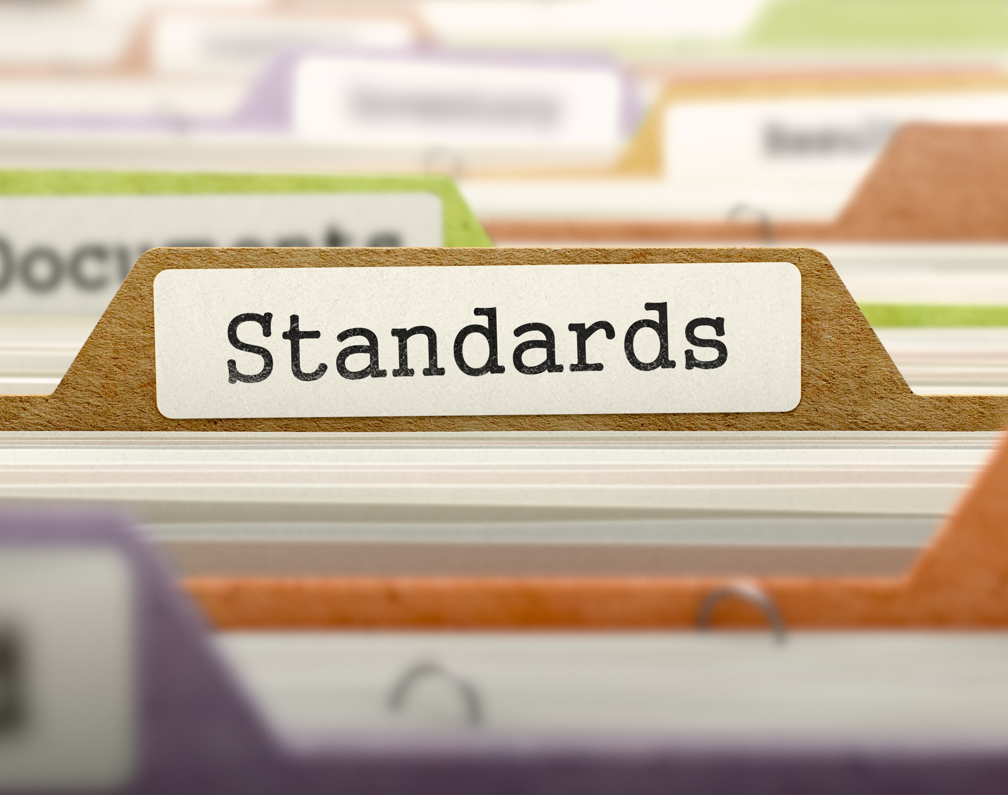
Process
Types of Technical Debt
Notes:
Process debt : Refers to inefficient processes, for example, processes for which the initial use case is no longer appropriate.

Slide 66

Requirement
Types of Technical Debt
Notes:
Requirement debt : Refers to tradeoffs made with respect to the specific requirements the development team has to implement or how to implement them. Examples include requirements that are only partially implemented, or requirements that are implemented but not for all cases.

Slide 67

Service
Types of Technical Debt
Notes:
Service debt : Refers to debt incurred by the need for web service substitution, which can be driven by business or technical objectives. The technical debt can span several dimensions related to selection, composition, and operation of the service.

Slide 68
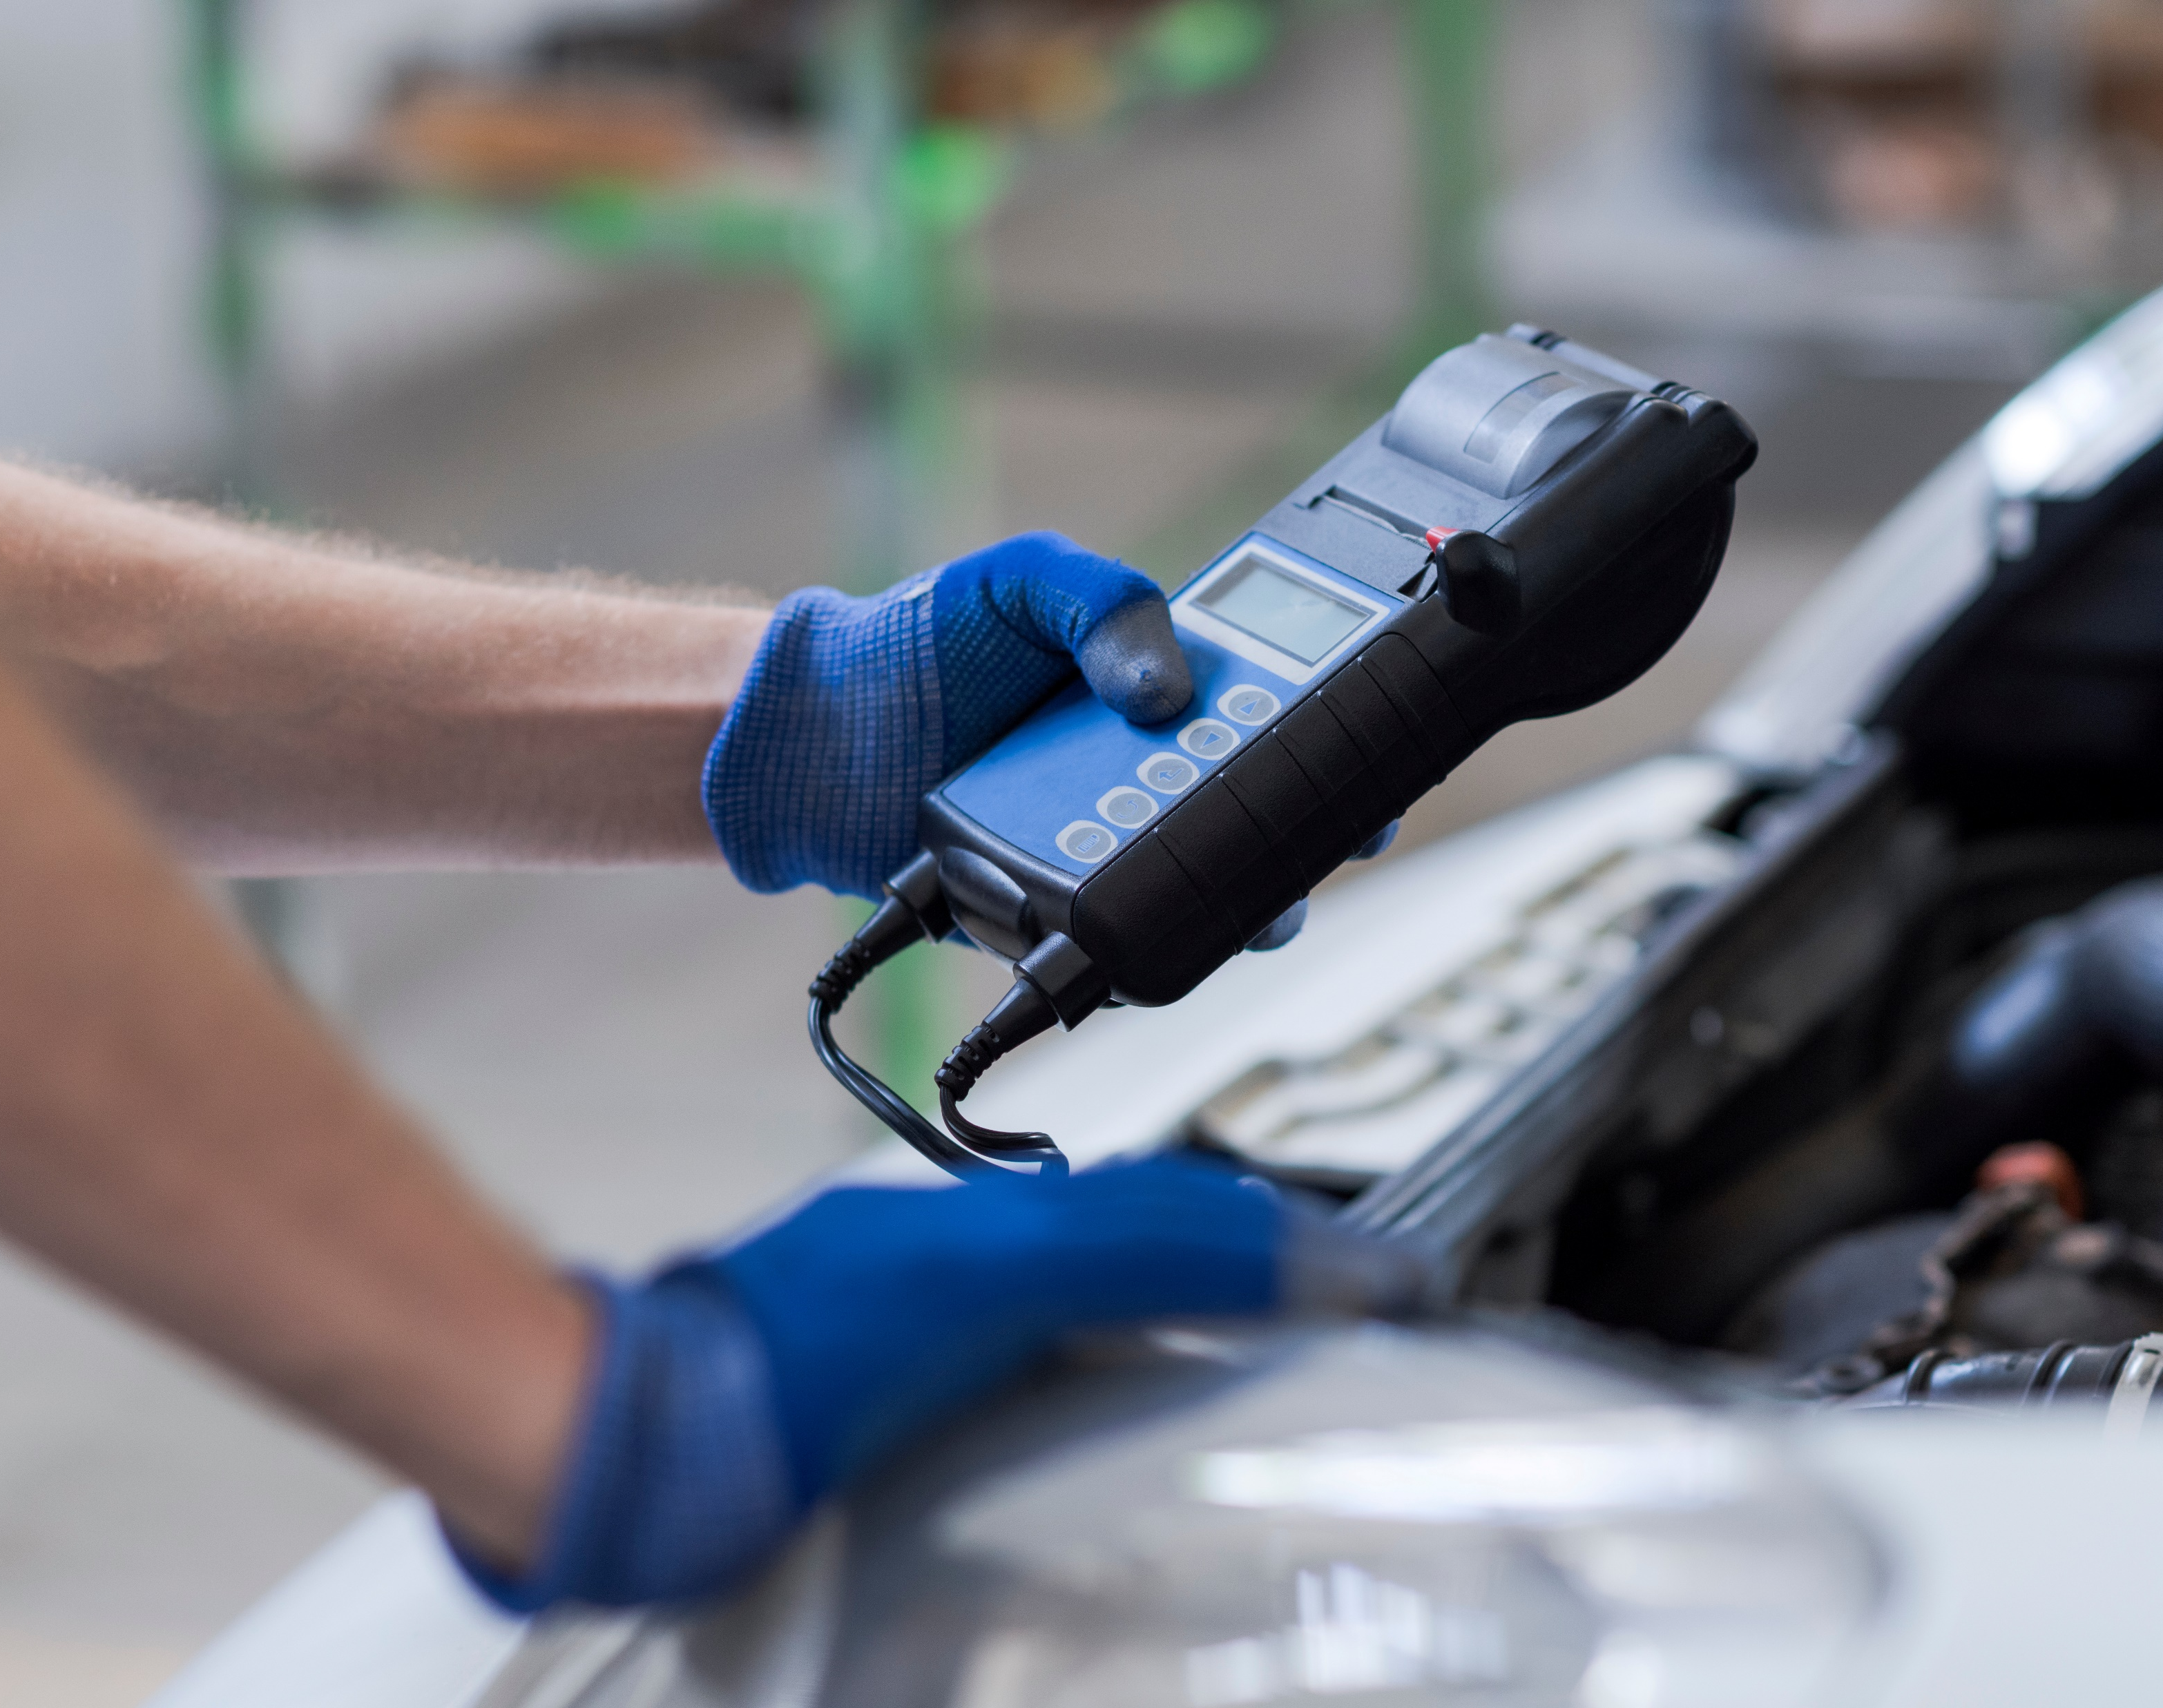
Test Automation
Types of Technical Debt
Notes:
Test automation debt : Refers to the work needed to automate tests of previously developed functionality to support continuous integration and faster development cycles.

Slide 69

Test
Types of Technical Debt
Notes:
Test debt : Refers to issues that can affect the quality of testing activities. Examples of this type of debt are planned tests that were not run, poor code coverage, or other known deficiencies in the test suite.

Slide 70
Technical Debt Identification
Technical Debt is not Free

Slide 71
Technical Debt Identification
Code Quality
Clarity
Notes:
Clarity – Easy to read and legible to anyone who has not written the code themselves

Slide 72
Technical Debt Identification
Code Quality
Maintainability
Notes:
Maintainability – Easy to understand the context and not being over-complicated makes it easier to make changes in the code when required

Slide 73
Technical Debt Identification
Code Quality
Documentation
Notes:
Documentation – While well-written code explains itself, it is always recommended to add comments to explain the role it plays and its functions

Slide 74
Technical Debt Identification
Code Quality
Refactored
Notes:
Refactored – The formatting needs to consistent and follow relevant coding conventions

Slide 75
Technical Debt Identification
Code Quality
Well-Tested
Notes:
Well-tested – The lest amount of bugs a software has, the higher its quality is. Rigorous testing helps filter out such discrepancies.

Slide 76
Technical Debt Identification
Code Quality
Efficiency
Notes:
Efficiency – High-quality code uses the resources available so it optimally performs the desired action

Slide 77
Technical Debt Identification
Code Quality
Technical Deficiencies
Have other teams built similar solutions?
Notes:
Have other teams built similar solutions for similar needs? If so, can they be condensed into one solution or into less complex solutions with shared maintenance?

Slide 78
Technical Debt Identification
Code Quality
Technical Deficiencies
Are there inconsistent user experiences?
Notes:
Are there inconsistent user experiences for the same processes?

Slide 79
Technical Debt Identification
Code Quality
Technical Deficiencies
Are solutions using the same
reusable frameworks?
Notes:
Are solutions following the same reusable frameworks?

Slide 80
Technical Debt Identification
Code Quality
Technical Deficiencies
Are best practices being followed?
Notes:
Are solutions built following best practices?

Slide 81
Technical Debt Identification
Code Quality
Technical Deficiencies
Are deployments taking too long?
Notes:
Are deployments or package validations taking too long?

Slide 82
Technical Debt Identification
Code Quality
Technical Deficiencies
Are limits being exceeded,
or are users seeing errors?
Notes:
Are limits being exceeded, or are users seeing errors for SQL, DML record locks, API calls, or CPU time limits?

Slide 83
Technical Debt Identification
Code Quality
Technical Deficiencies
Business Misalignment

Slide 84
Technical Debt Identification
Code Quality
Technical Deficiencies
Business Misalignment

Slide 85

Code Reviews
Opportunities to Identify Technical Debt

Slide 86
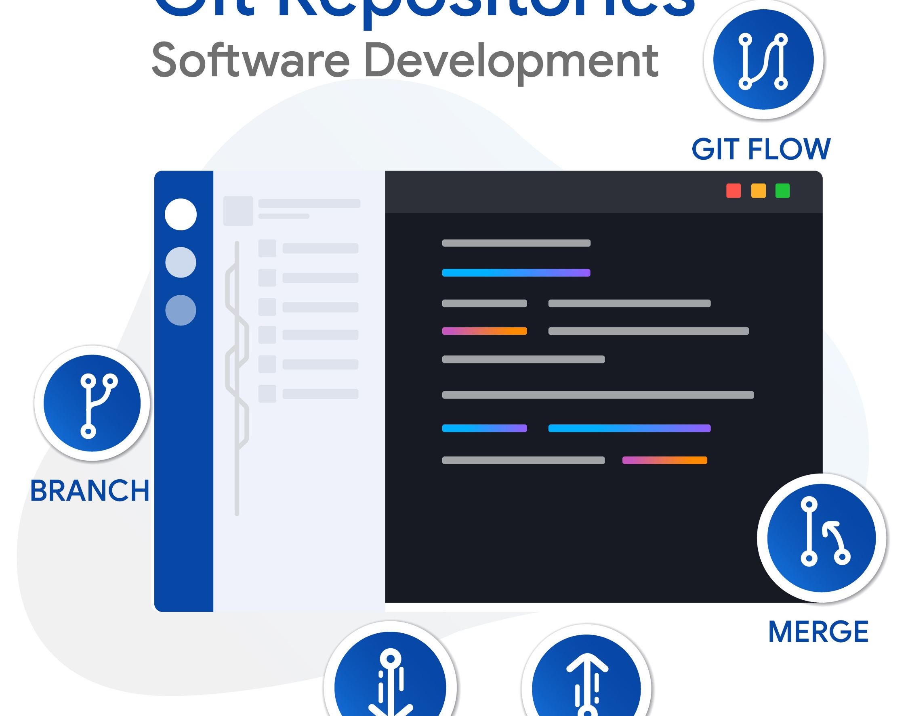
Pull Requests
Opportunities to Identify Technical Debt

Slide 87

Sprint Review
Opportunities to Identify Technical Debt

Slide 88

Stand Up
Opportunities to Identify Technical Debt

Slide 89

Coding
Opportunities to Identify Technical Debt

Slide 90

Manifesto for Software Craftsmanship
Not only working software,
but also well-crafted software
Not only responding to change
but also steadily adding value
Not only individuals and interactions
but also a community of professionals
Not only customer collaboration
but also productive partnerships
Notes:
As aspiring Software Craftsmen we are raising the bar of professional software development by practicing it and helping others learn the craft. Through this work we have come to value:

Slide 91

Code Analysis Tools
Opportunities to Identify Technical Debt

Slide 92

Often hidden in plain sight
Opportunities to Identify Technical Debt

Slide 93

Recording Technical Debt
User Story
Product Backlog Item
Requirement
Issue
Notes:
Agile – User Story
Scrum – Product Backlog item
CMMI – Requirement
Basic - Issue

Slide 94

Recording Technical Debt
User Story
Product Backlog Item
Requirement
Issue
Bug

Slide 95
Key Information to Record
Problem Statement
We need to refactor our SSO.
Notes:
Add business context when communicating technical debt.
Communicating the need for technical debt projects to business leaders is crucial, but often a challenge for technical leaders.

Slide 96
Key Information to Record
Problem Statement
In 22Q1, 20% of system outages were due to the SSO service straining under scale constraints. Given our focus on the enterprise segment, we are taking some time this quarter to ensure that part of the system is ready for us to continue to scale up this segment.
Notes:
By linking technical debt projects to measurable business outcomes, you make it easier to boost their priority, get approval for such projects, and make sure everyone understands the outcomes and why they are relevant to the entire company.

Slide 97
Key Information to Record
Problem Statement
Story Points
Criticality
Complexity
Reward
Remediation Cost
Notes:
Criticality – 1 to 5
Complexity – 1 to 5; how hard is it to solve the problem
Reward – 1 to 5 where 1 is a nice to have and 5 is a significantly measurable improvement both from a performance, security, complexity, etc. point of view

Slide 98
Tracking Technical Debt
Technical Debt is not Free

Slide 99

Tracking Technical Debt

Slide 100

Tracking Technical Debt

Slide 101

Technical Debt Register
Product
User Story #
Title
Criticality
Complexity
Reward
Remediation Cost
Technical Debt Score

Slide 102
Technical Debt Score
R : Reward
Cr : Criticality
Co: Complexity
(R x .2) + (CR x .15) - (CO x .15)

Slide 103
Technical Debt Score
R : Reward
Cr : Criticality
Co: Complexity
(R x .2) + (CR x .15) - (CO x .15)

Slide 104
Technical Debt Score
(R x .2) + (CR x .15) - (CO x .15)
Criticality (CR) | Complexity (CO) | Reward (R) | Score
5 | 1 | 5 | 1.6

Slide 105
Technical Debt Score
(R x .2) + (CR x .15) - (CO x .15)
Criticality (CR) | Complexity (CO) | Reward (R) | Score
5 | 1 | 5 | 1.6
1 | 5 | 1 | -0.4

Slide 106
Technical Debt Score
(R x .2) + (CR x .15) - (CO x .15)
Criticality (CR) | Complexity (CO) | Reward (R) | Score
5 | 1 | 5 | 1.6
1 | 5 | 1 | -0.4
3 | 2 | 3 | 0.75

Slide 107
Technical Debt Score
(R x .2) + (CR x .15) - (CO x .15)
Criticality (CR) | Complexity (CO) | Reward (R) | Score | Rank
5 | 1 | 5 | 1.6 | 1
1 | 5 | 1 | -0.4 | 3
3 | 2 | 3 | 0.75 | 2

Slide 108

Notes:
AirPort, PowerBooks, MacBook Pro, iPod

Slide 109
Technical Debt Ratio
Technical Debt is not Free
Notes:
A simple ratio can show the technical debt as a relationship between the cost to fix the software system and the cost of developing it.

Slide 110
Technical Debt Ratio
(Remediation Cost / Development Cost) x 100%
Project | Remediation Cost | Development Cost | Technical Debt Ratio
Project 1 | 12.1 | 3633.12 | 0.33%

Slide 111
Technical Debt Ratio
(Remediation Cost / Development Cost) x 100%
Project | Remediation Cost | Development Cost | Technical Debt Ratio
Project 1 | 12.1 | 3633.12 | 0.33%
Project 2 | 702 | 18,728.55 | 3.75%

Slide 112
Technical Debt Ratio
(Remediation Cost / Development Cost) x 100%
Project | Remediation Cost | Development Cost | Technical Debt Ratio
Project 1 | 12.1 | 3633.12 | 0.33%
Project 2 | 702 | 18,728.55 | 3.75%
Project 3 | 1,058.25 | 9,593.37 | 11.03%

Slide 113
Summary
Technical Debt is not Free

Slide 114
Technical Debt is not Free
What is technical debt?
Notes:
What is technical debt?
A state of unnecessary complexity, duplication, subpar code, or otherwise deficient code that introduces risks in the form of time, quality, security, team morale, or other forms. Typically the results of past action or inaction.
Technical debt can be bad, it can be devastating; but it could also be useful and beneficial

Slide 115
Technical Debt is not Free
What is technical debt?
Pros and cons of technical debt
Notes:
Pros
Faster time to market
Short term competitive advantage
Short term capital preservation
Cons
Degradation of quality
Limits innovation
Longer development cycles
Reduces responsiveness to market changes
Higher upgrade costs
System compatibility issues
Poor end user experience
Develop

Slide 116
Technical Debt is not Free
What is technical debt?
Pros and cons of technical debt
Causes of technical debt
Notes:
Insufficient up-front definition
Business pressures
Tightly-coupled components
Parallel development
Lack of alignment to standards
Lack of knowledge
Poor technical leadership
Last minute specification changes

Slide 117
Technical Debt is not Free
What is technical debt?
Pros and cons of technical debt
Causes of technical debt
Types of technical debt
Notes:
Architecture
Build
Code
Defect
Design
Documentation
Infrastructure
People
Process
Requirement
Service
Test Automation
Test

Slide 118
Technical Debt is not Free
What is technical debt?
Pros and cons of technical debt
Causes of technical debt
Types of technical debt
Identifying technical debt
Notes:
Code Quality
Technical Deficiencies
Business Misalignment
Code Reviews
Pull Requests
Sprint Reviews
Stand Up
Coding
Code Analysis Tools

Slide 119
Technical Debt is not Free
What is technical debt?
Pros and cons of technical debt
Causes of technical debt
Types of technical debt
Identifying technical debt
Recoding technical debt
Notes:
Record in backlog
Probably not bugs
Add business context when communicating technical debt
Key Information to Record
Problem Statement
Story Points
Criticality
Complexity
Reward
Remediation Cost

Slide 120
Technical Debt is not Free
What is technical debt?
Pros and cons of technical debt
Causes of technical debt
Types of technical debt
Identifying technical debt
Recoding technical debt
Technical Debt Score
(R x .2) + (CR x .15) - (CO x .15)

Slide 121
Technical Debt is not Free
What is technical debt?
Pros and cons of technical debt
Causes of technical debt
Types of technical debt
Identifying technical debt
Recoding technical debt
Technical Debt Score
Technical Debt Ratio
(Remediation Cost / Development Cost)
x 100%

Slide 122
Thank You!
chadgreen@chadgreen.com
TaleLearnCode
ChadGreen.com
ChadGreen & TaleLearnCode
ChadwickEGreen

